Slide 1
Programming Fundamental
Week 02
Sobia Iftikhar
Sobia.Iftikhar@nu.edu.pk

Slide 2
Class 04 14-Sep-2021

Slide 3
Content
Problem solving with decisions and iterative structures.
Basic Computer Organization.
Intro to IDE (compiled program, text editors, debuggers, etc).
Program structure and Execution.
First Program with Input and Output

Slide 4
Summary of Previous Week
How to solve the problem ?
What type of the solution we have for the problems?
Difficulties in Problem Solving?
Algorithm and Pseudo code?
Problem solved by the computer?

Slide 5
Structuring a Program
Develop efficient computer solution to problems:
Use modules—break the whole into parts, with each part having a particular function.
Use the three logic structures to ensure that the solution flows smoothly from one instruction to the next, rather than jumping from one point in the solution to another.
The sequential structure executes instructions one after another in a sequence.
The decision structure branches to execute one of two possible sets of instructions
The loop structure executes a set of instructions many times.
Eliminate the rewriting of identical processes by using modules.
Use techniques to improve readability, including the four logic structures, proper naming of variables, internal documentation, and proper indentation.

Slide 6
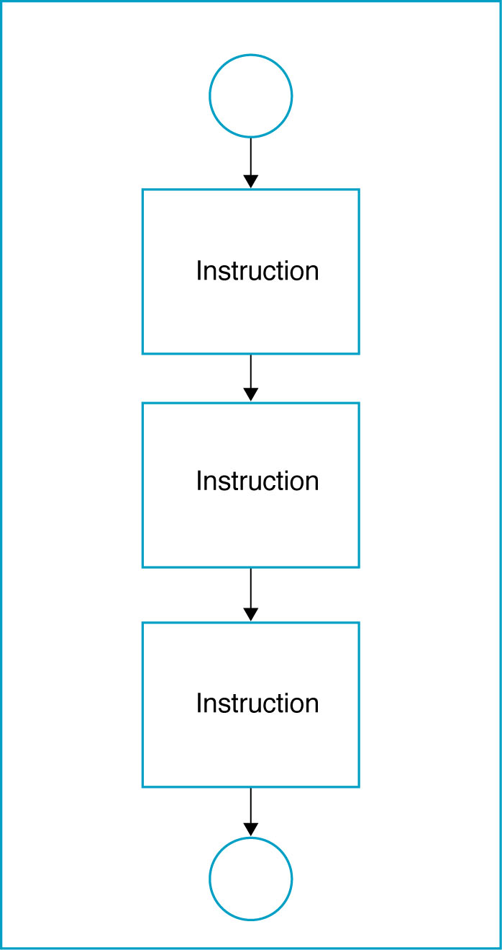
a. Sequential Logic Structure
Sequential structure directs the computer to process the program instruction, one after another in order of listed program

Slide 7
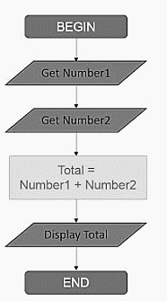
Example Basic Calculator
A program is to be developed that allow a user to enter in two different numbers. The software is to add the numbers and display the result.

Slide 8
b. Decision Logic Structure
Implements using the IF/THEN/ELSE instruction.
Tells the computer that IF a condition is true, THEN execute a set of instructions, or ELSE execute another set of instructions
ELSE part is optional, as there is not always a set of instructions if the conditions are false.
Algorithm:
IF <condition(s)> THEN
<TRUE instruction(s)>
ELSE
<FALSE instruction(s)

Slide 9
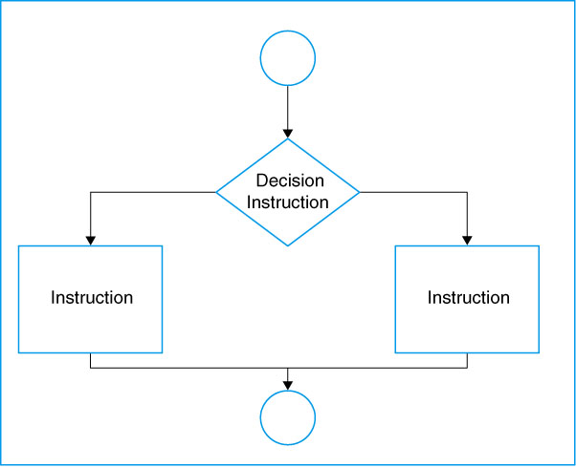
Decision Logic Structure

Slide 10
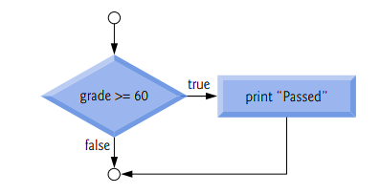
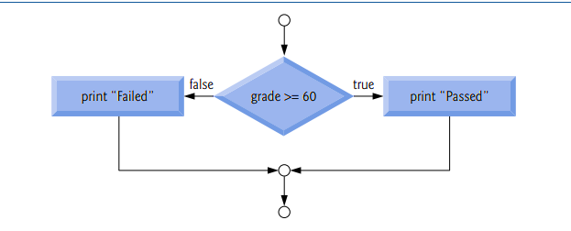
Example
For example, suppose the passing grade on an exam is 60.
Algorithmic statement
If student’s grade is greater than or equal to 60 Print “Passed”
if ( grade >= 60 )
{
puts( "Passed" );
} // end if
if ( grade >= 60 ) {
puts( "Passed" );
} // end if
else {
puts( "Failed" );
}
C-structure

Slide 11
Examples of conditional expressions
A < B (A and B are the same data type – either numeric, character, or string)
X + 5 >= Z (X and Z are numeric data)
E < 5 or F > 10 (E and F are numeric data)

Slide 12
Example
Assume your are calculating pay at an hourly rate, and overtime pay(over 40 hours) at 1.5 times the hourly rate.
IF the hours are greater than 40, THEN the pay is calculated for overtime, or ELSE the pay is calculated in the usual way.

Slide 13
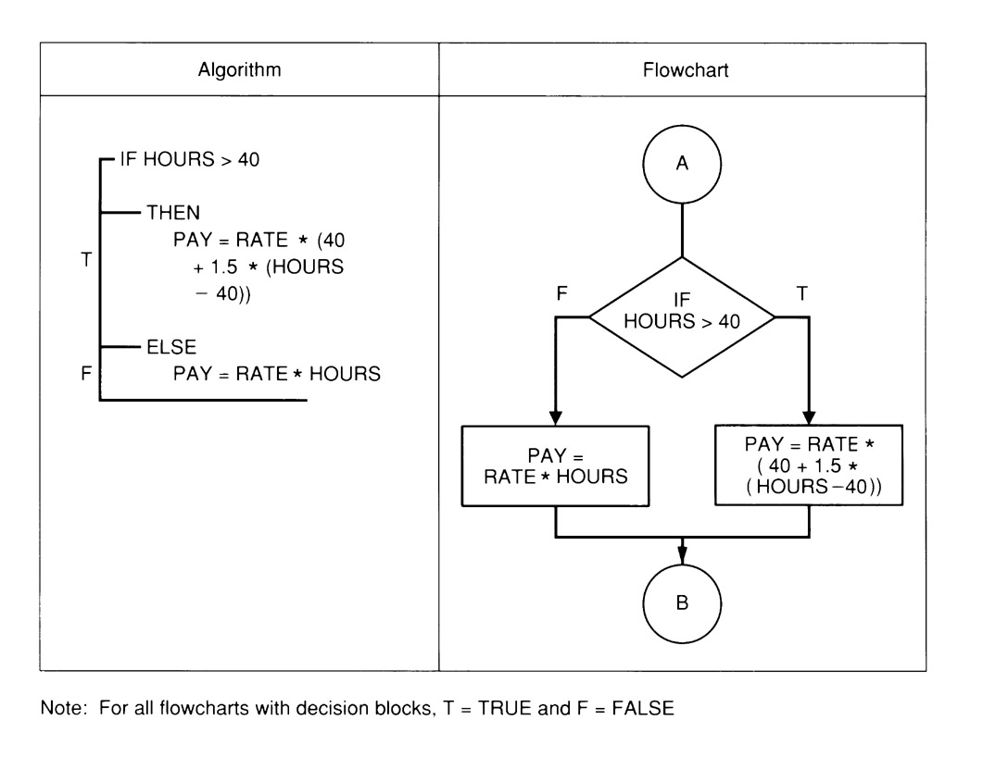
Example Decision Structure

Slide 14
NESTED IF/THEN/ELSE INSTRUCTIONS
Multiple decisions.
Instructions are sets of instruction in which each level of a decision is embedded in a level before it.
Nested if…else statements test for multiple cases by placing if…else statements inside if…else statements

Slide 15
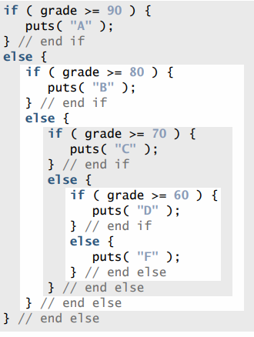
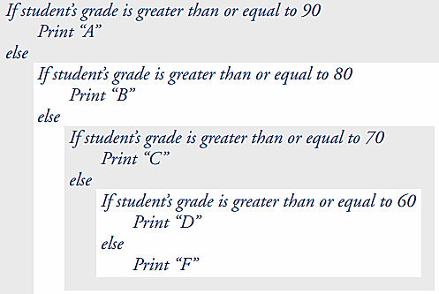
NESTED IF/THEN/ELSE INSTRUCTIONS
For example, the following pseudo code statement will print:
A for exam grades greater than or equal to 90,
B for grades greater than or equal to 80 (but less than 90),
C for grades greater than or equal to 70 (but less than 80),
D for grades greater than or equal to 60 (but less than 70), and F for all other grades.

Slide 16
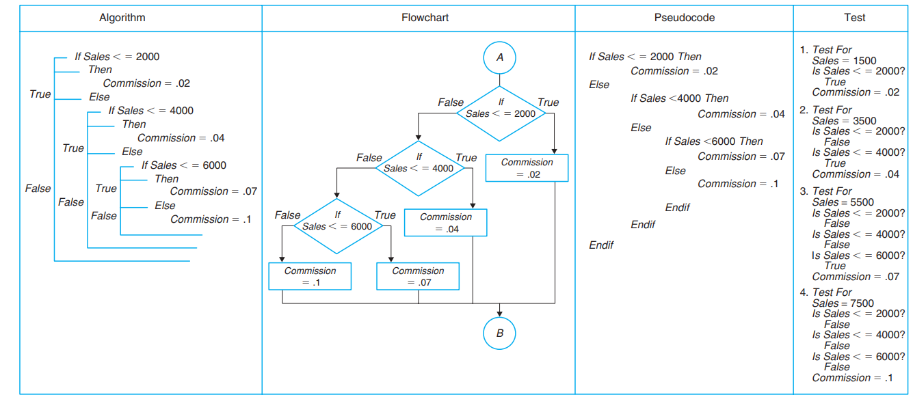

Slide 17
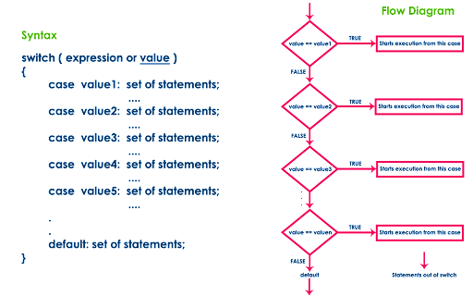
Switch Structure

Slide 18
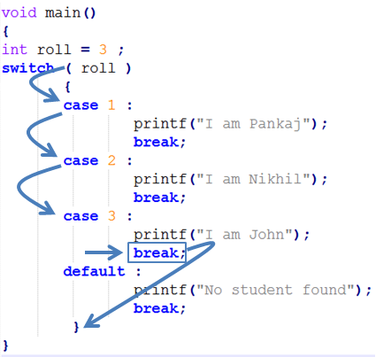
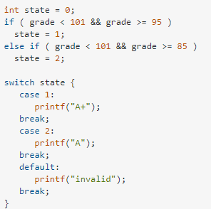
Example

Slide 19
c. Loop Logic Structure
Repeat structure
To solve the problem that doing the same task over and over for different sets of data
Types of loop:
WHILE loop
Do WHILE loop
Automatic-Counter Loop

Slide 20
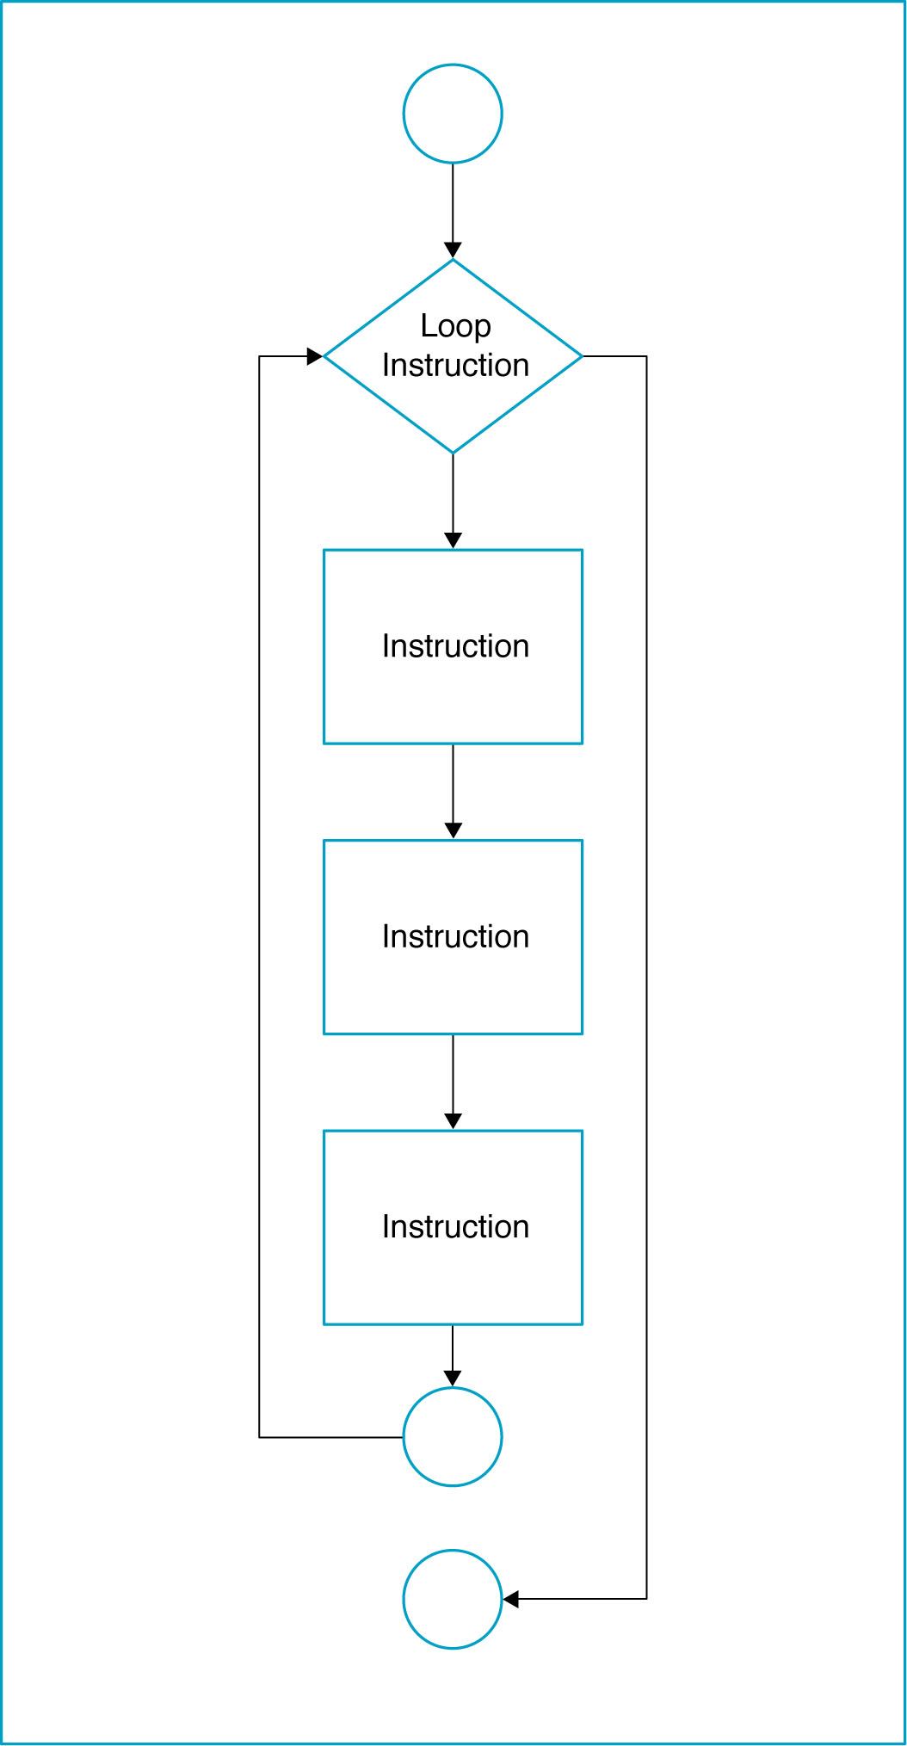
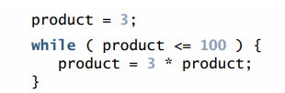
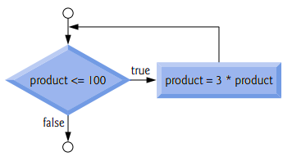
Loop Logic Structure
As an example of a while statement, consider a program segment designed to find the first power of 3 larger than 100.

Slide 21
WHILE loop
Do the loop body if the condition is true.
Example: Get the sum of 1, 2, 3, …, 100.
Algorithm:
Set the number = 1
Set the total = 0
While (number <= 100)
total = total + number
number = number + 1
End While
Display total

Slide 22
WHILE loop
Start
Set number = 1
Set total = 0
number <= 100
No
Yes
Display total
total =
total + number
End
number =
number + 1

Slide 23
Class 05 09-Sep-2021

Slide 24
DO WHILE Loop
The body of the loop will process first before check the condition.
Example: Get the sum of 1, 2, 3, …100.

Slide 25
DO WHILE Loop
Start
Int n1=1;
Int total =0;
Do{
total = total+n1;
n1= n1+1;
}While(n1<=100);
Print total;
Set number = 1
Set total = 0
total =
total + number
No
number =
number + 1
Display total
Yes
number <= 100
End

Slide 26
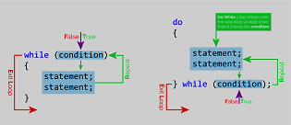
Difference (while & Do-while)
Int i=5;
While(i<=5){
printf(“Sobia”);
i++;
}
Int i=5;
Do{
printf(“Sobia”);
i++;
}While(i<=5);

Slide 27
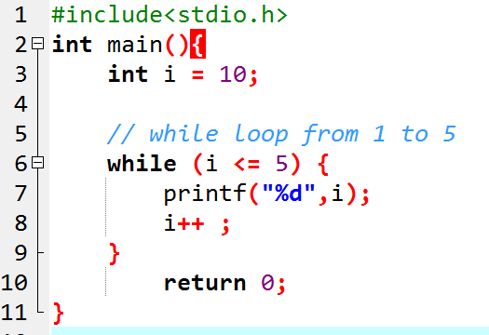
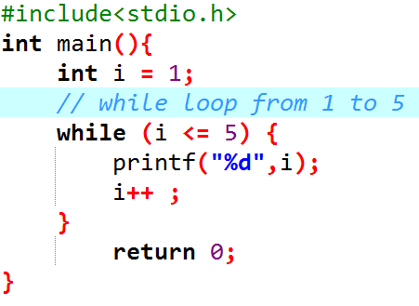
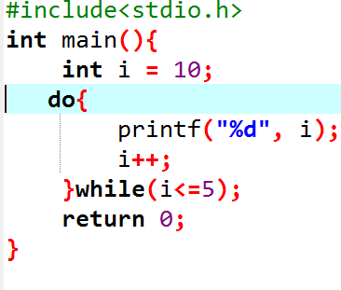
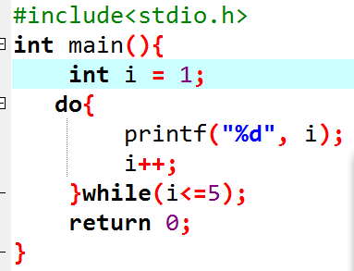




Example
Example 1: Display Numbers from 1 to 5

Slide 28
Automatic Counter Loop
Use variable as a counter that starts counting at a specified number and increments the variable each time the loop is processed.
The beginning value, the ending value and the increment value may be constant. They should not be changed during the processing of the instruction in the loop.

Slide 29
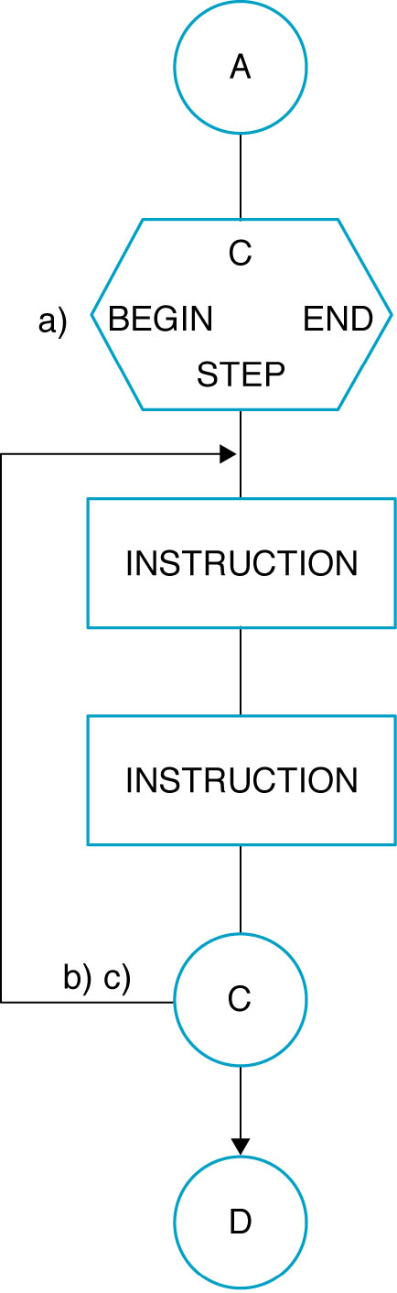
Automatic-Counter Loop

Slide 30
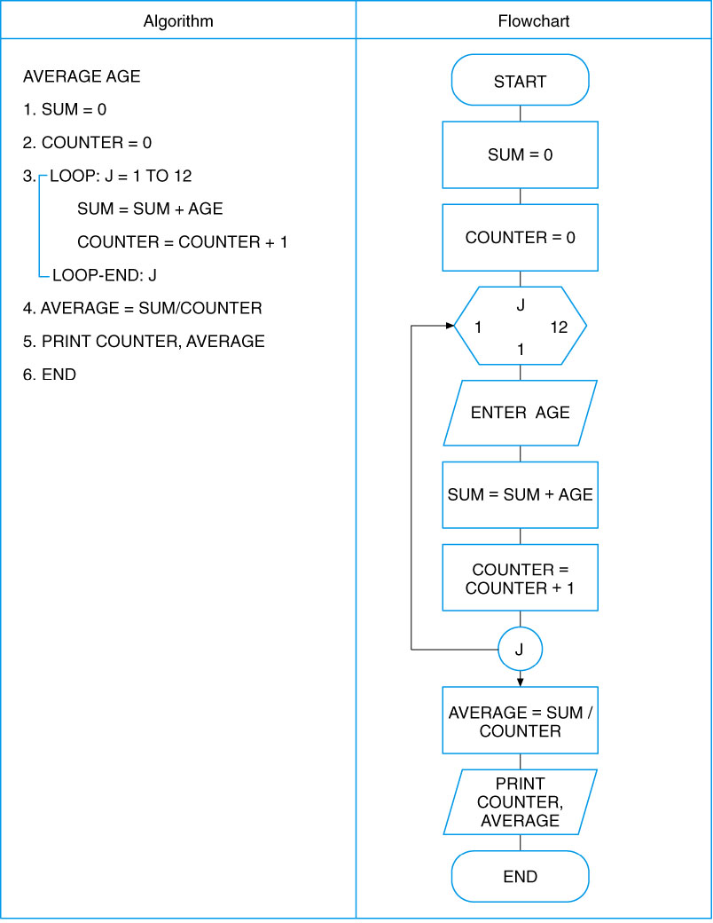
Automatic-Counter Loop

Slide 31
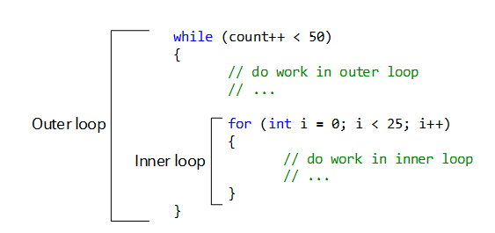
Nested Loop

Slide 32
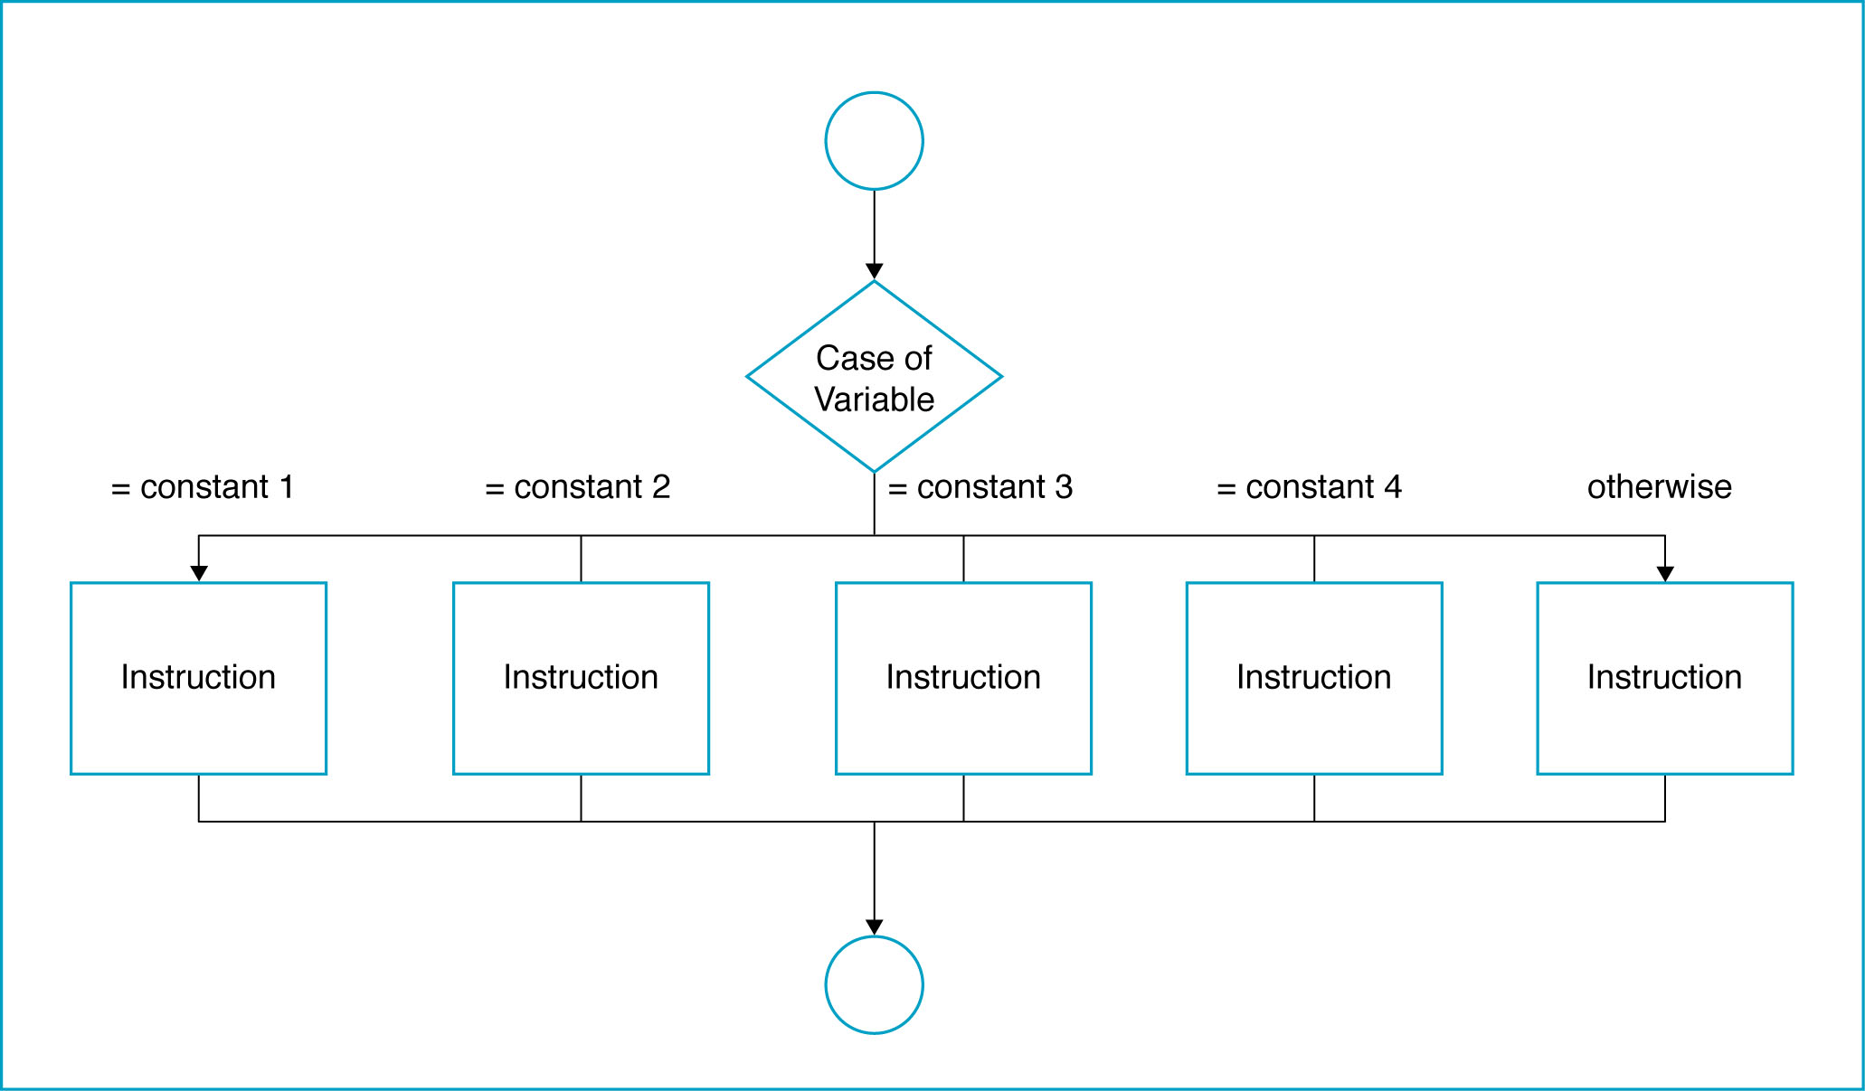
The Case Logic Structure
Made up of several or many sets of instructions, only one of which will be selected by the user and executed by the computer

Slide 33
Case Logic Structure
Example: A company has four different medical plans. The programmer has given each plan a code corresponding to the beginning initial of the company: Plan 1 = F, Plan 2 = B, Plan 3 = K, Plan 4 = E.
The company pays for all of Plan 1. The individual has to pay for part of the others. The payroll deduction for Plan 2 = 4.65, for Plan 3 = 7.85, and for Plan 4 = 5.50. Any other codes are considered in error.
Write the algorithm and draw the flowchart for a module to determine the payroll deduction.

Slide 34
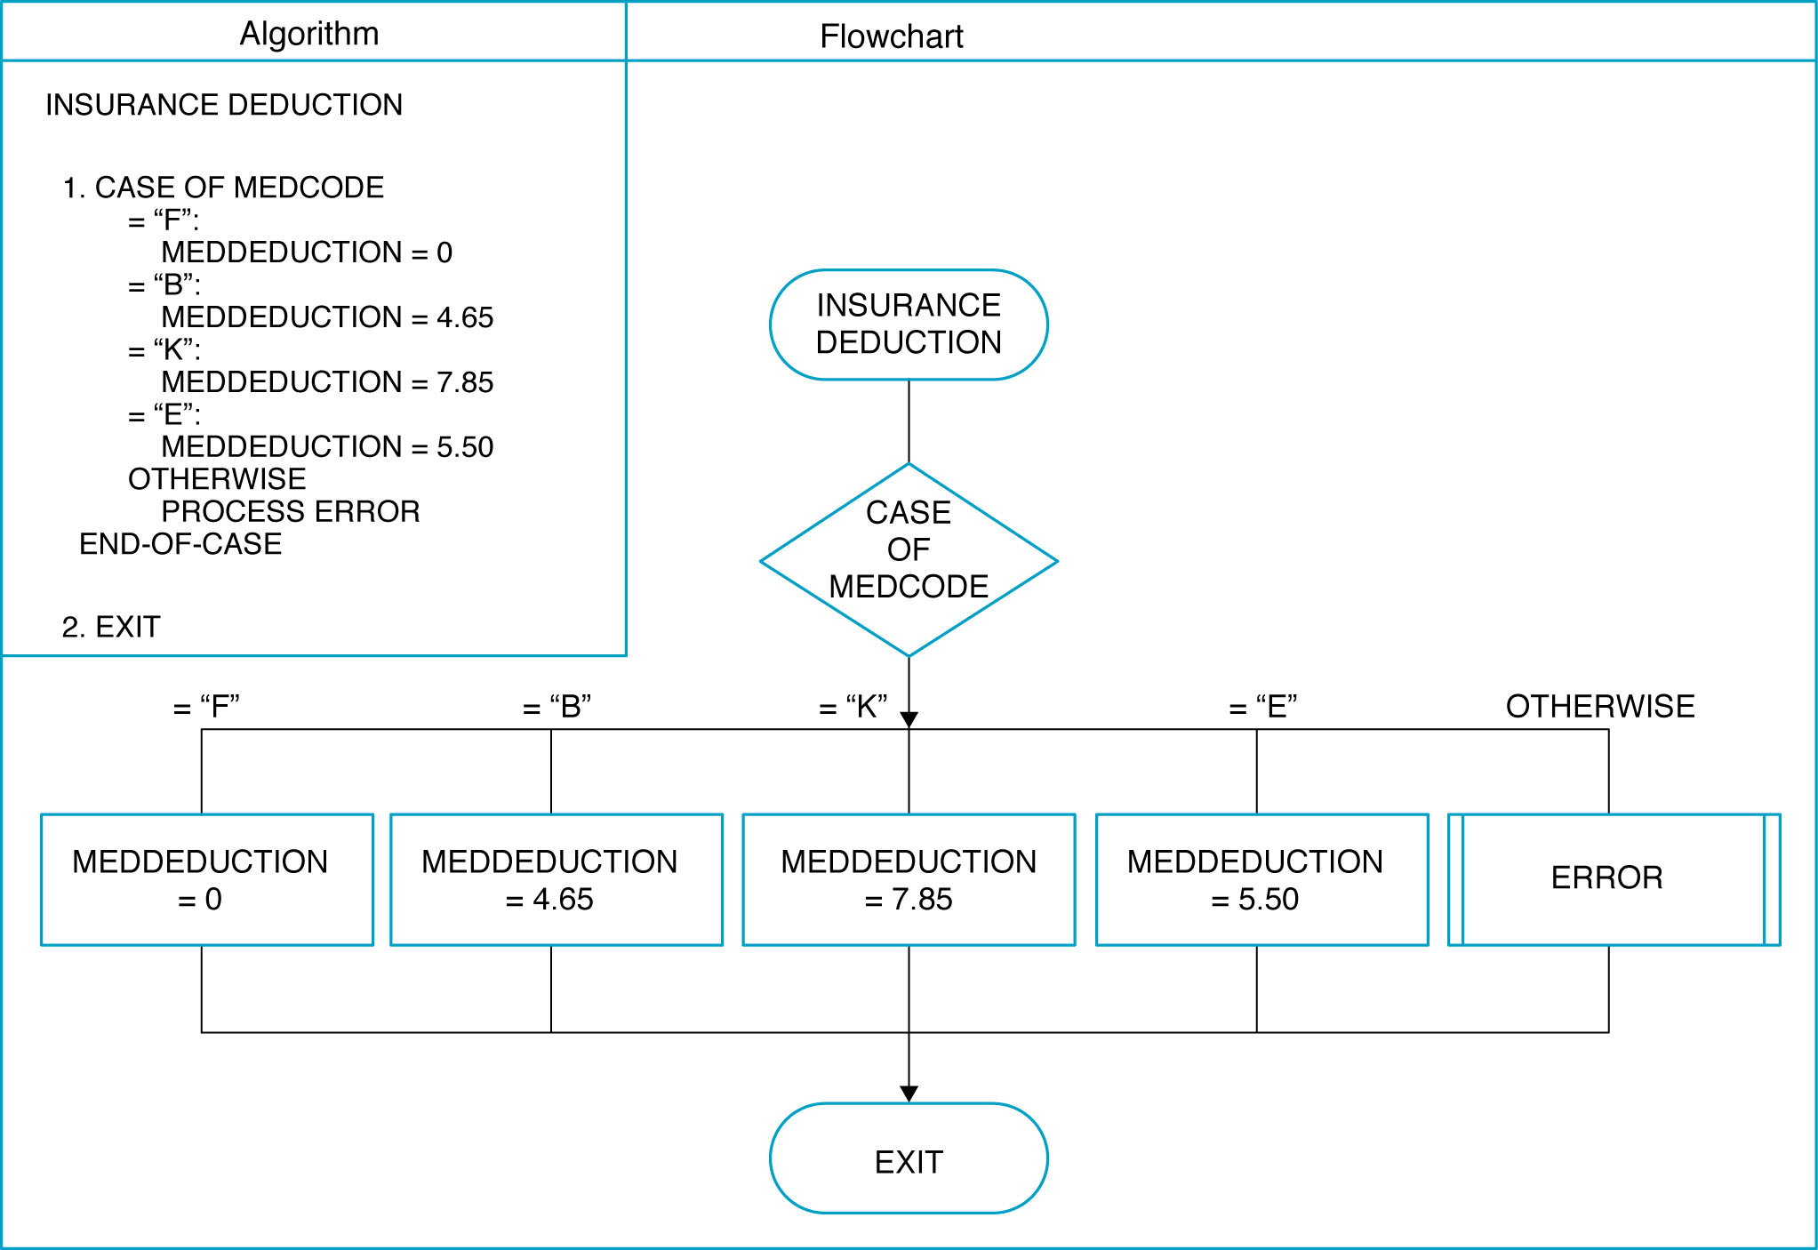
Example of Case Logic Structure

Slide 35
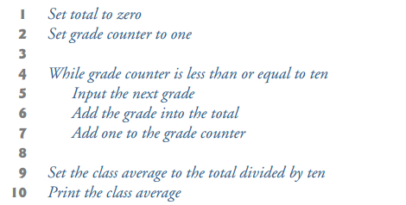
Task
A class of ten students took a quiz. The grades (integers in the range 0 to 100) for this quiz are available to you. Determine the class average on the quiz.

Slide 36
TASK
Write an algorithm and also draw a flowchart to login to facebook account

Slide 37
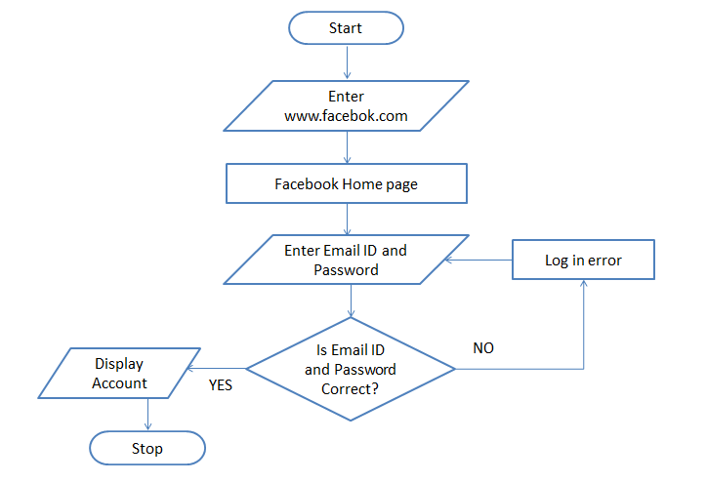
TASK
Write an algorithm and also draw a flowchart to login to facebook account
Enter www.facebook.com in your browser. (I/O)
facebook Home page loads (PROCESS)
Enter your Email ID and Password (I/O)
Is Email ID and Password Valid (DECISION)
if NO then Log in error (PROCESS) go to step 3 else Display Facebook Account (I/O) Stop

Slide 38
TASK
Write Algorithm & Flowchart to print multiplication Table of a number.

Slide 39
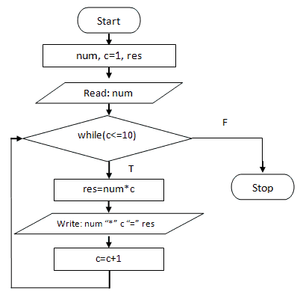
TASK
Write Algorithm & Flowchart to print multiplication Table of a number.
step 1: read number
step 2: count = 1;
step 3: if
count<=10
continue
else
Stop
step 4: table = number *count
step 5: Print table
step 6: count = count+1, Go to step 3.

Slide 40
TASK
Draw flowchart to find the largest among three different numbers entered by user. Let say the numbers are A, B and C.

Slide 41
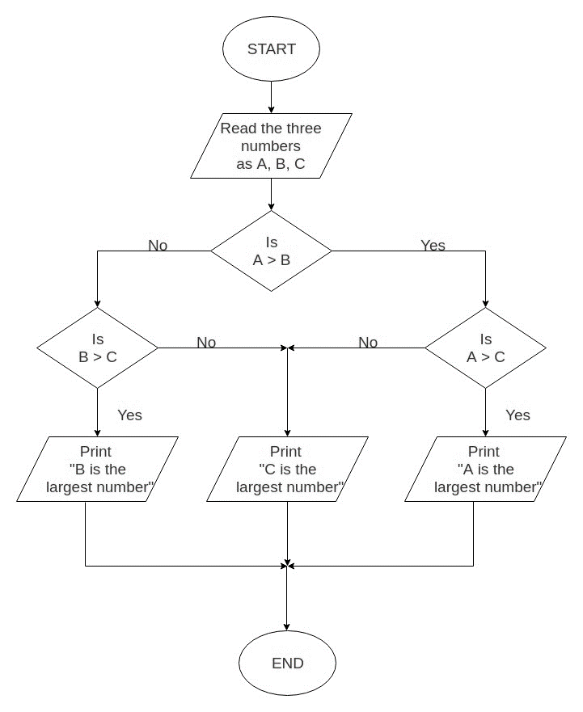
TASK
Draw flowchart to find the largest among three different numbers entered by user. Let say the numbers are A, B and C.

Slide 42
TASK
Write an algorithm and also draw flowchart for calculate factorial value of a number:

Slide 43
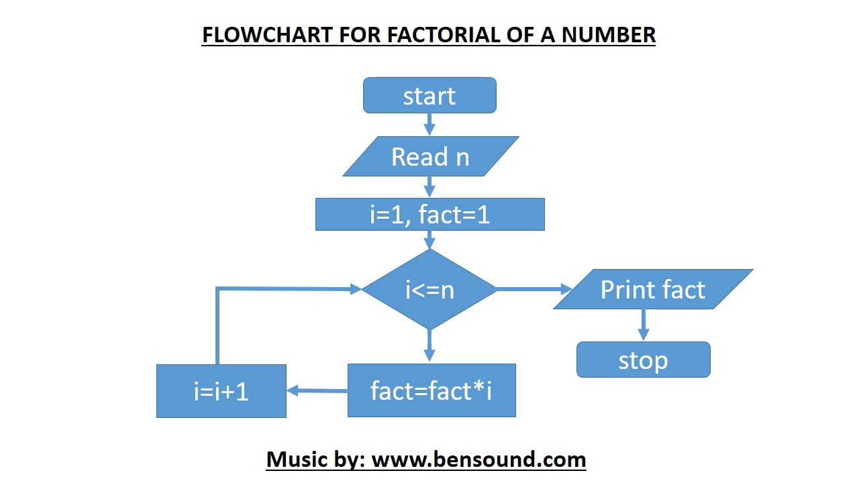
TASK
Write an algorithm and also draw flowchart for calculate factorial value of a number:
step 1. Start step 2. Read the number n step 3. [Initialize] i=1, fact=1 step 4. Repeat step 4 through 6 until i=n step 5. fact=fact*i step 6. i=i+1 step 7. Print fact step 8. Stop

Slide 44
Class 06 09-Sep-2021

Slide 45
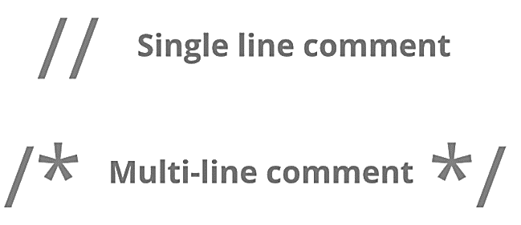
Program Header Comment
A comment is descriptive text used to help a reader of the program understand its content.
All comments must begin with the characters /* and end with the characters */
These are called comment delimiters
The program header comment always comes first.

Slide 46
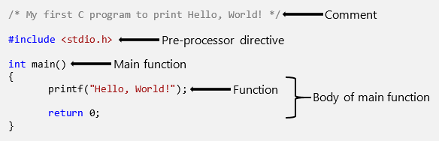
The Function Body

Slide 47
Preprocessor Directives
Lines that begin with a # are called preprocessor directives (commands).
Example: the #include <stdio.h> directive causes the preprocessor to include a copy of the standard input/output header file stdio.h at this point in the code.
This header file was included because it contains information about the printf ( ) function that is used in this program.

Slide 48
stdio.h
When we write our programs, there are libraries of functions to help us so that we do not have to write the same code over and over.
Some of the functions are very complex and long. Not having to write them ourselves make it easier and faster to write programs.
Using the functions will also make it easier to learn to program!

Slide 49
void/int main (void)
Every program must have a function called main. This is where program execution begins.
main() is placed in the source code file as the first function for readability.
The reserved word “void” indicates that main() returns nothing.
The parentheses following the reserved word “main” indicate that it is a function.
The reserved word “void” means nothing is there.

Slide 50
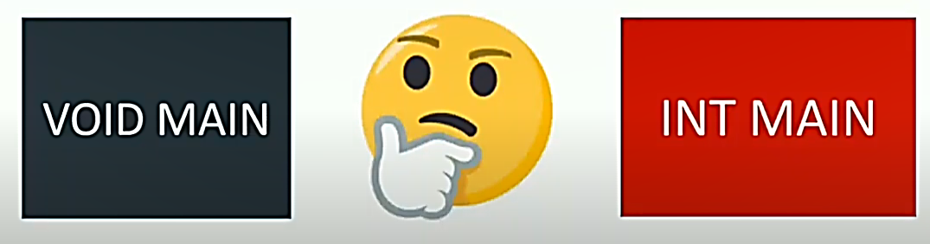
Question

Slide 51
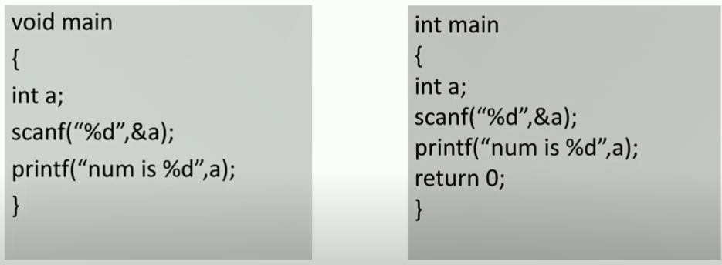
When we return 0 at the end ( while using int as the return type) it tells the OS that the program is functional and is without any error(except logical error), as main function is called by OS and it returns 0 to the OS.

Slide 52
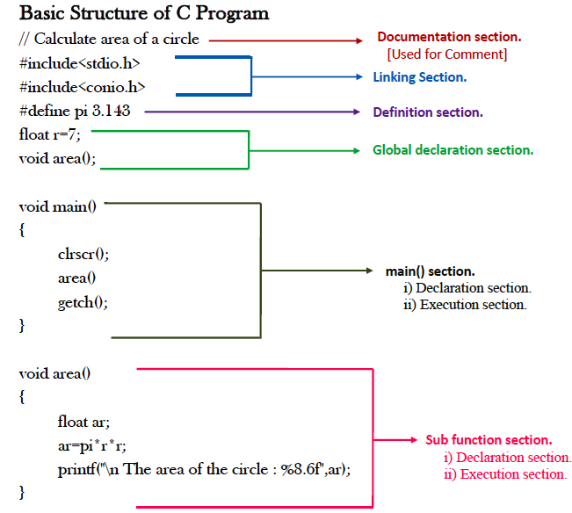
Function body

Slide 53
printf (“Hello, World!\n”);
This line is a C statement.
It is a call to the function printf ( ) with a single argument (parameter), namely the string “Hello, World!\n”.
Even though a string may contain many characters, the string itself should be thought of as a single quantity.
Notice that this line ends with a semicolon. All statements in C end with a semicolon.

Slide 54
getch();
getch() is built-in function
By using this function at end of file, it holds your output screen until you press any character.

Slide 55
scanf() Funtion
Syntax:
scanf (“ format specifier ”, & var_name);
Obtains a value from the user
scanf() uses standard input (usually keyboard)
This scanf statement has two arguments
Format specifier -indicates format of the data
& var_name - location in memory to store variable
& is confusing in beginning – for now, just remember to include it with the variable name in scanf statement
When executing the program the user responds to the scanf statement by typing in a number, then pressing the enter (return) key

Slide 56
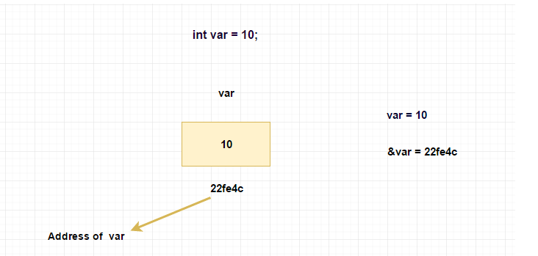
Example

Slide 57
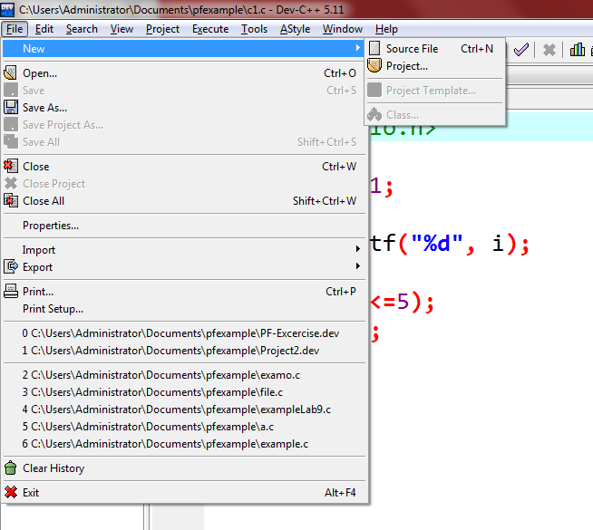
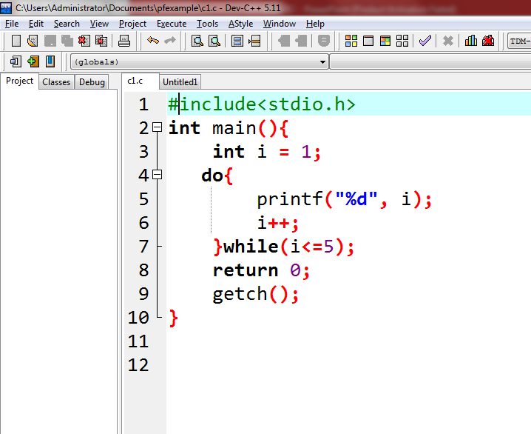
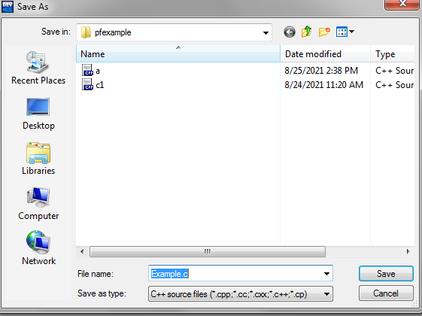
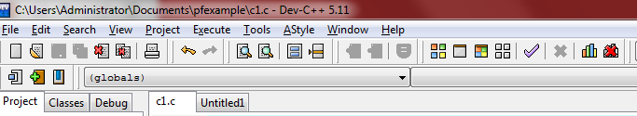
Enviroment of IDE

Slide 58
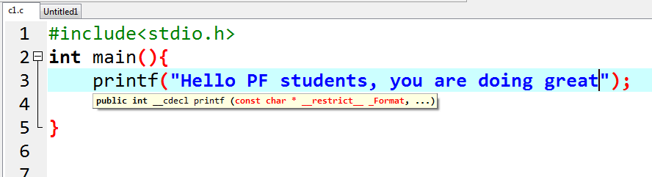
First C Program on IDE
Write a C program to print your name/any text.

Slide 59
Input and output program
#include<stdio.h>
void main()
{
// defining a variable
int i;
/*
displaying message on the screen
asking the user to input a value
*/
printf("Please enter a value...");
/*
reading the value entered by the user
*/
scanf("%d", &i);
/*
displaying the number as output
*/
printf( "\nYou entered: %d", i);
}

Slide 60
#include<stdio.h>
int main()
{
int age;
float weight;
printf("Enter age and weight\n");
//getting input from the user and storing it into memory addresses
scanf("%d%f",&age,&weight);
printf("age = %d \nweight = %f \n",age,weight);
return 0;
}

Slide 61
Variables
Define the variables
Naming Variables
Using variables
Initialize the variables

Slide 62
Thankyou

